Slide 1

Apartment Comparison Tool
Hayden Williford
Jack Callahan
Lillian Bowling
Matthew Rostar

Slide 2

Dataset
UC Irving Machine Learning Repository
100k Records of Apartments in the US
21 Variables
Variables of Interest
Title, Price, Amenities, Bedrooms, Bathrooms, Square Feet, City, Pets, Latitude and Longitude

Slide 3



Problem Statement
“Should I renew my lease at my current apartment? If not, what are similar options near me?”
Current websites require signing up, providing personal information and answering many questions
Only show apartments in your area based on some algorithm
Requires users to evaluate their current apartment on their own

Slide 4
EDA
Removing Non-Apartment Options
Condensed all pet options to binary feature
Removed records with missing values in the desired features
Removed Outlier Apartments
Price
Square Feet
Bedrooms/Bathrooms

Slide 5
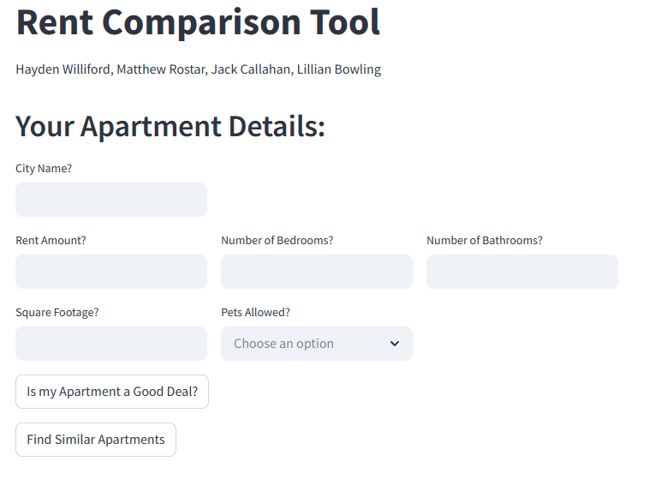

Slide 6
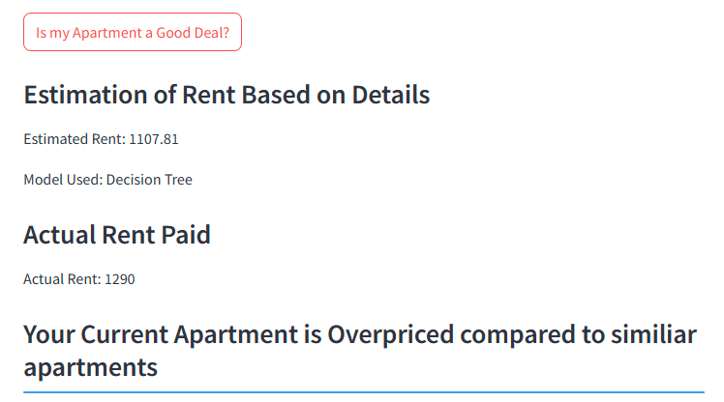

Slide 7
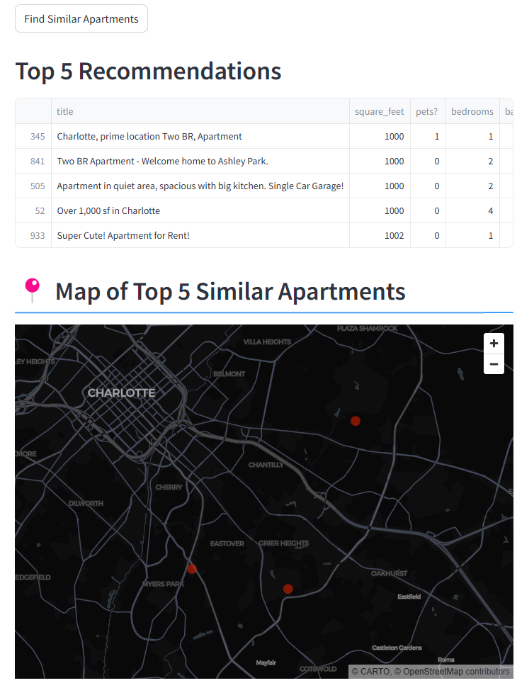

Slide 8
Challenges
Using Longitude and Latitude as a Feature
Scaling Issues when Normalized
1 Unit Difference can be up to 70 miles Before Scaling
After scaling, the differences were overpowered by other binary features
Deciding Best Similarity Based Learning Method
KNN vs K-Means
Unpredictable Cluster of Interest Size

